Slide 1

Hope Foundation’s Finolex Academy of Management and Technology
Department of Information Technology
NETWORKING FOR FIVE STAR HOTEL
Presented By :
Amrish Sanjay Tembe (T-16-0029)
Swaraj Sadanand Shinde (T-16-0085)
Tanvi Anil Sawant (T-16-0083)
Under the guidance of :
Mr. Atul B. Yadav

Slide 2
Contents
Introduction
Design Phases
Prepare Phase
Plan Phase
Design Phase
Implementation Phase
Operate Phase
Optimize Phase
Conclusion
References

Slide 3
Introduction
The current networking present is tedious to control for non-technical user.
Hotel networking technology is growing day by day.
One of the biggest challenges of hotels today is keeping the in-venue experience more compelling for guests.
The main goal of the proposed system is to more accurately represent users needs.

Slide 4
Prepare Phase
Organizational Goals
Network Specification Required
Networking Requirement
Technology used
Architecture

Slide 5
Prepare Phase
Network Design Strategies
Hierarchical, Resilient, Modular, High Performance, High Profitability
Technology Used
WLAN access
Access Points
Wireless LAN Controller (WLC)
Wireless Services Module (WiSM2)
Voice services
Cisco Unified Communications Manager 8.6 (2a) or 9.1(2)
Cisco Unified IP Phone 7975 or 9971
Integrated Services Router (for Voice Gateway Services)
Video delivery
Vision Director
Digital Media Player
Encoders, transcoders, and receivers Switches

Slide 6
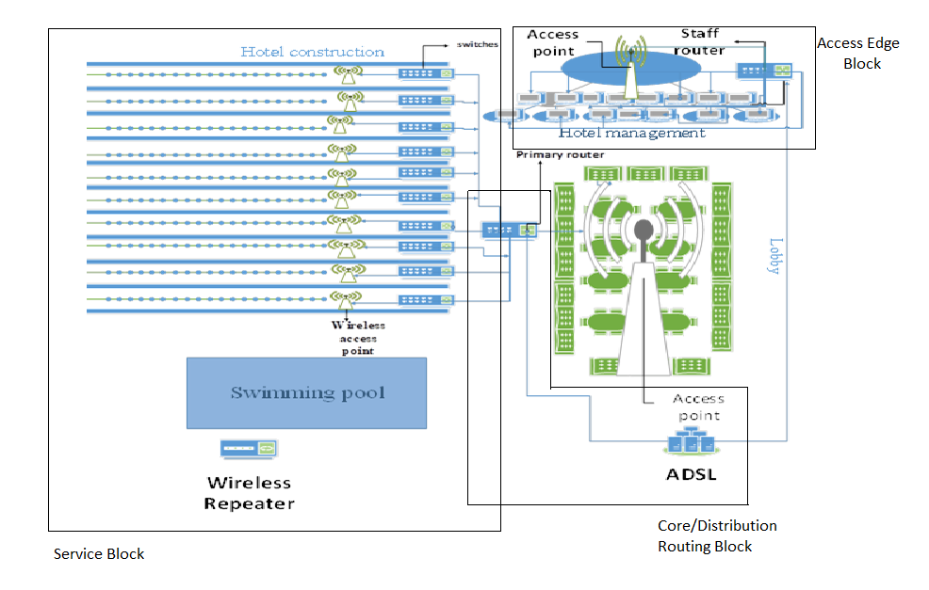
Architecture

Slide 7
Plan Phase
Gap Analysis
Hotel Infrastructure and expectations
Project Plan
Software planning
Hardware planning
Device planning
User access control
Design Requirements
Capacity
Handoff Management
Inference Management

Slide 8
Design Phase
Network Design strategy
Ip network segregation
Access Control
Access point configuration
Design Principles
Hierarchy
Modularity
Resiliency
Flexibility
Cost Effectiveness
Cost effectiveness

Slide 9
Implementation Phase
Selecting Core devices
Selecting Access devices
Proposed solution characteristics
Hotel Network Security with SSID, MMF, IP source guard
Integration of services
Router stability

Slide 10
Operate Phase
Security firewall Deployment
Firewalls are deployed to guarantee the security between the core switches and Internet routers.
Identify single points of failure, Plan for fault tolerance, Standby hardware, Fast boot methods, Backup power, Total remote management, Concurrent backup and restore.
Operation to maintain health and prevent problems
Identify single point of failure
Plan for fault tolerance
Remote management
Backup power

Slide 11
Optimize Phase
Major Risks
Network shows signal but don’t work
Network inaccessible files
IP conflicts
Slow application response
Poor VoIP quality

Slide 12
Conclusion
In this case study we have studied an enterprise network system for Stadium, by following guidelines specified by CISCO for Enterprise Network Design PPDIOO phases.
Re-imagining the modern hotel as a technology and business platform has significant implications for the hotel industry.
We have studied designing methodologies involved in network design for Hotel. We learn about all phases in design process. We have come to know about the tools, components and budget for designing network for this system.

Slide 13
References
1. https://www.slideshare.net/jagrutib22/hotel-casestudy-hyatt-regency-pune
2. https://www.al-enterprise.com/-/media/assets/internet/documents/ale-hospitality-networking-guide-en.pdf
3. http://www.ciscopress.com/articles/article.asp?p=1608131&seqNum=3
4. https://www.uniassignment.com/essay-samples/information-technology/design-project-for-a-5-star-hotel-information-technology-essay.php#
5. https://www.zyxel.com/solutions/Zyxel-Network-Solution-Shapes-Guests-Journey-at-Turkish-Five-Star-Hotel-20180213-499102.shtml
6. https://networkprojects.e-junkie.com/product/1091751
7. https://www.conceptdraw.com/How-To-Guide/hotel-network-topology-diagram
8. https://www.scte.org/documents/pdf/CCNA4%20Sample.pdf
9.https://www.cisco.com/web/partners/services/promos/accelerate/downloads/lifecycle_services_sg.pdf
10. https://www.ccexpert.us/network-design/network-design-methodology.html

Slide 14
THANK YOU...!!

